Slide 1
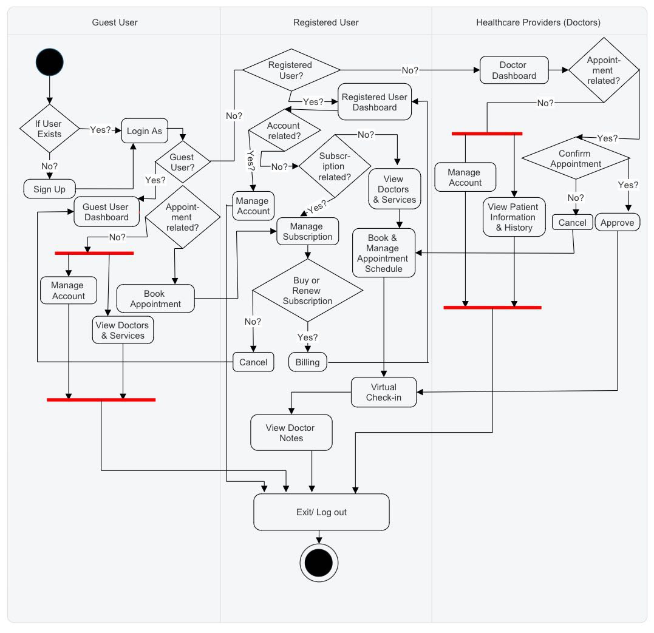
Healthify (Activity Diagram)

